Slide 1

A Smart Hiring & Portfolio Platform
PortfolioHub:
Team 4:
Hoang Nguyen
Thanh Nguyen

Slide 2

Overview
A smart hiring platform
Connects candidates and recruiters
Main purposes:
Helping candidates to showcase their potential and make it easier to find a job
Helping recruiters quickly find and evaluate the appropriate candidates.

Slide 3

Data Storage Approach
All data is stored using localStorage.
The data is only available on the current device and browser
Cannot log in from another device

Slide 4
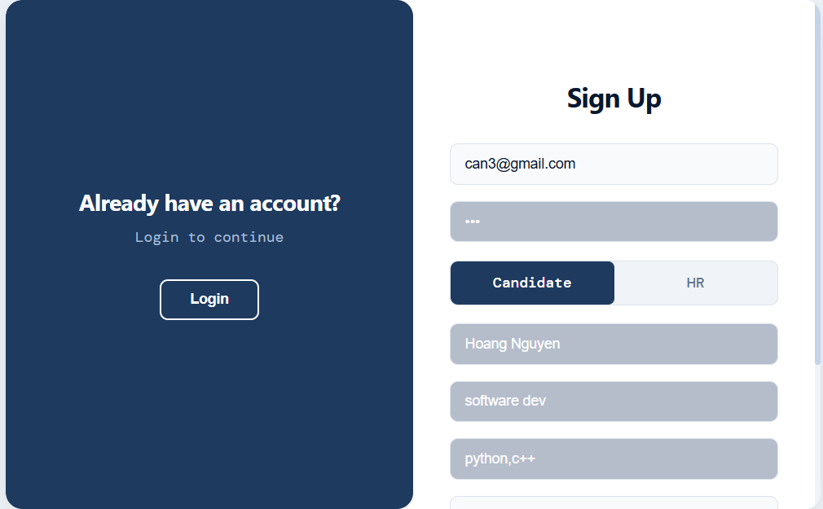

Slide 5
